Slide 1
Web Application Development
Team Project
Spring 2022-Team 22
Sprint2 Presentation
April 5, 2022
Team 22: Yiqin Han, Jintao Huang, Phoebe Li

Slide 2
Agenda
Project Overview
Sprint 1 & Sprint 2 Summary
The current progress
> Models & Database Design
> Functions
> UI
Final Deliverable plan
Our current Demo

Slide 3
Project Introduction
Quizmonkey, a better way to do the online quiz.
Easy Quiz Creation
Quizmonkey provide simple quiz creation template. You can assign questions and time to the quizlet, and assign weight to each questions.
Secure quiz access solution
Each quiz will have an unique PIN code. The creator can share this PIN code to the people who want to join the quiz. The participants will enter this code to get into the quiz.
Leaderboard
The Leaderboard will show the participants score for the quiz. The quiz creator can download the score distribution Excel file for the future analysis.

Slide 4
Sprint #1 Progress and Challenges
Progress:
Created beautiful front end pages
Figured out the models used in the project
Created the quiz creation demo by using Django Administration, which only allow superuser to create the quiz.

Slide 5
Sprint2 Summary
Designed the quizmonkey database.
Login and Logout for quiz creator
Implemented the quiz creation function.
> quiz creator can assign answers, weights to questions
> The quizlet has shareable link
> quiz creator can see the statictics details
User can see their score after submitting the quiz which they get through shared link

Slide 6
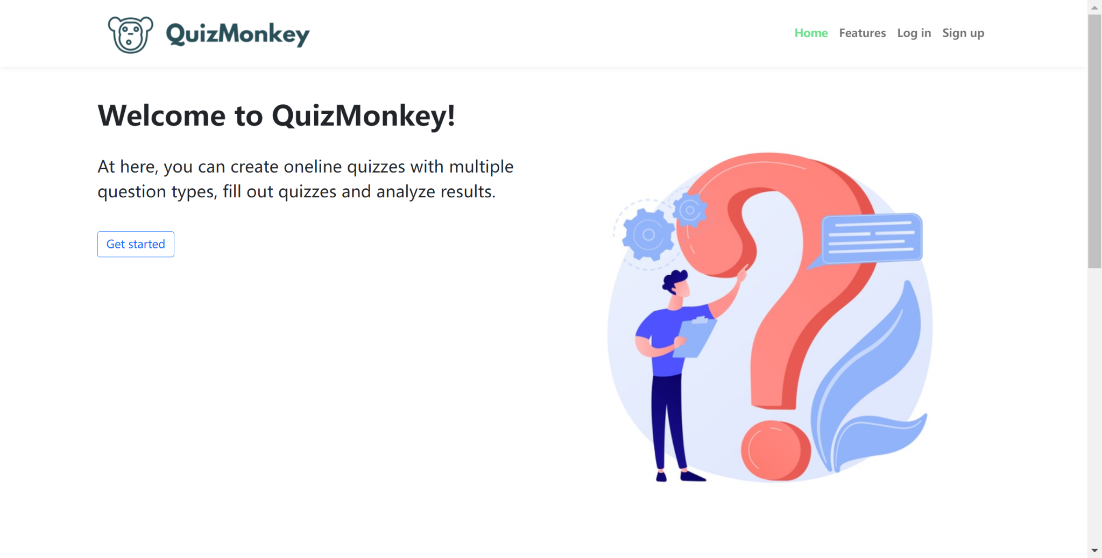
Front end pages (same as Sprint 1)
The welcome page

Slide 7
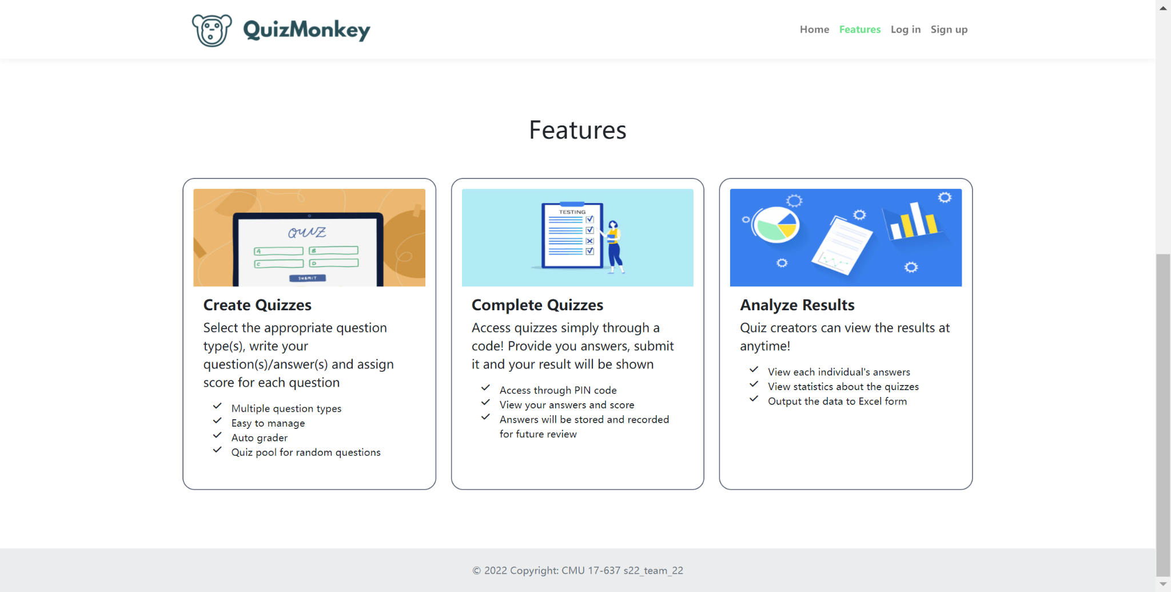
Front end pages
The feature page

Slide 8
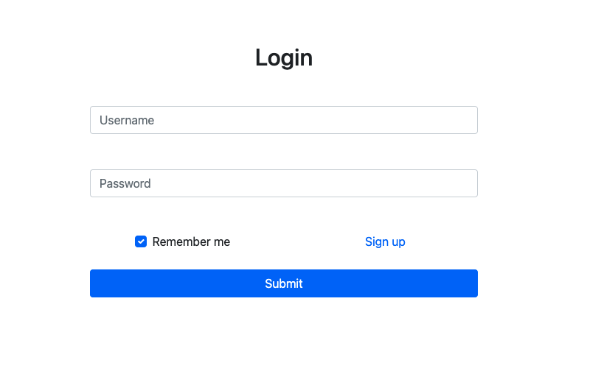
Login page

Slide 9
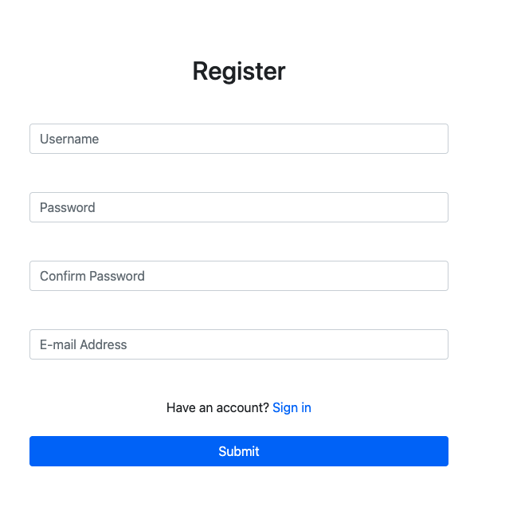
Register page

Slide 10
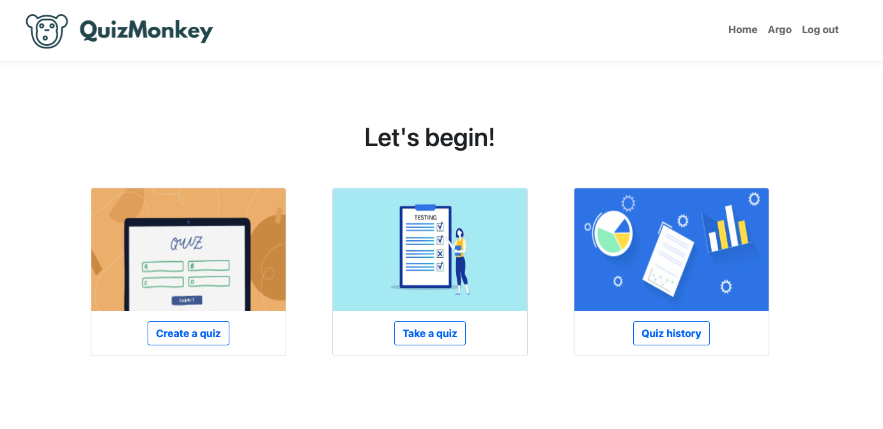
Front end pages
Choose one function to begin

Slide 11
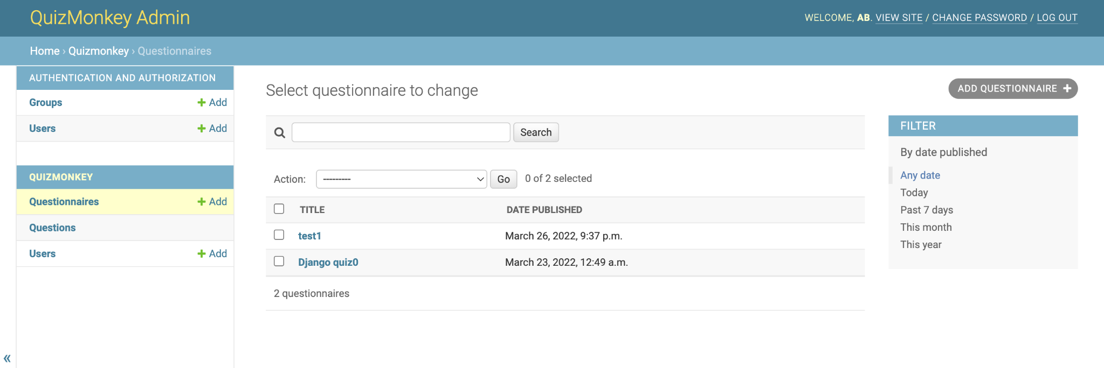
Quiz creation page (Sprint 1)

Slide 12
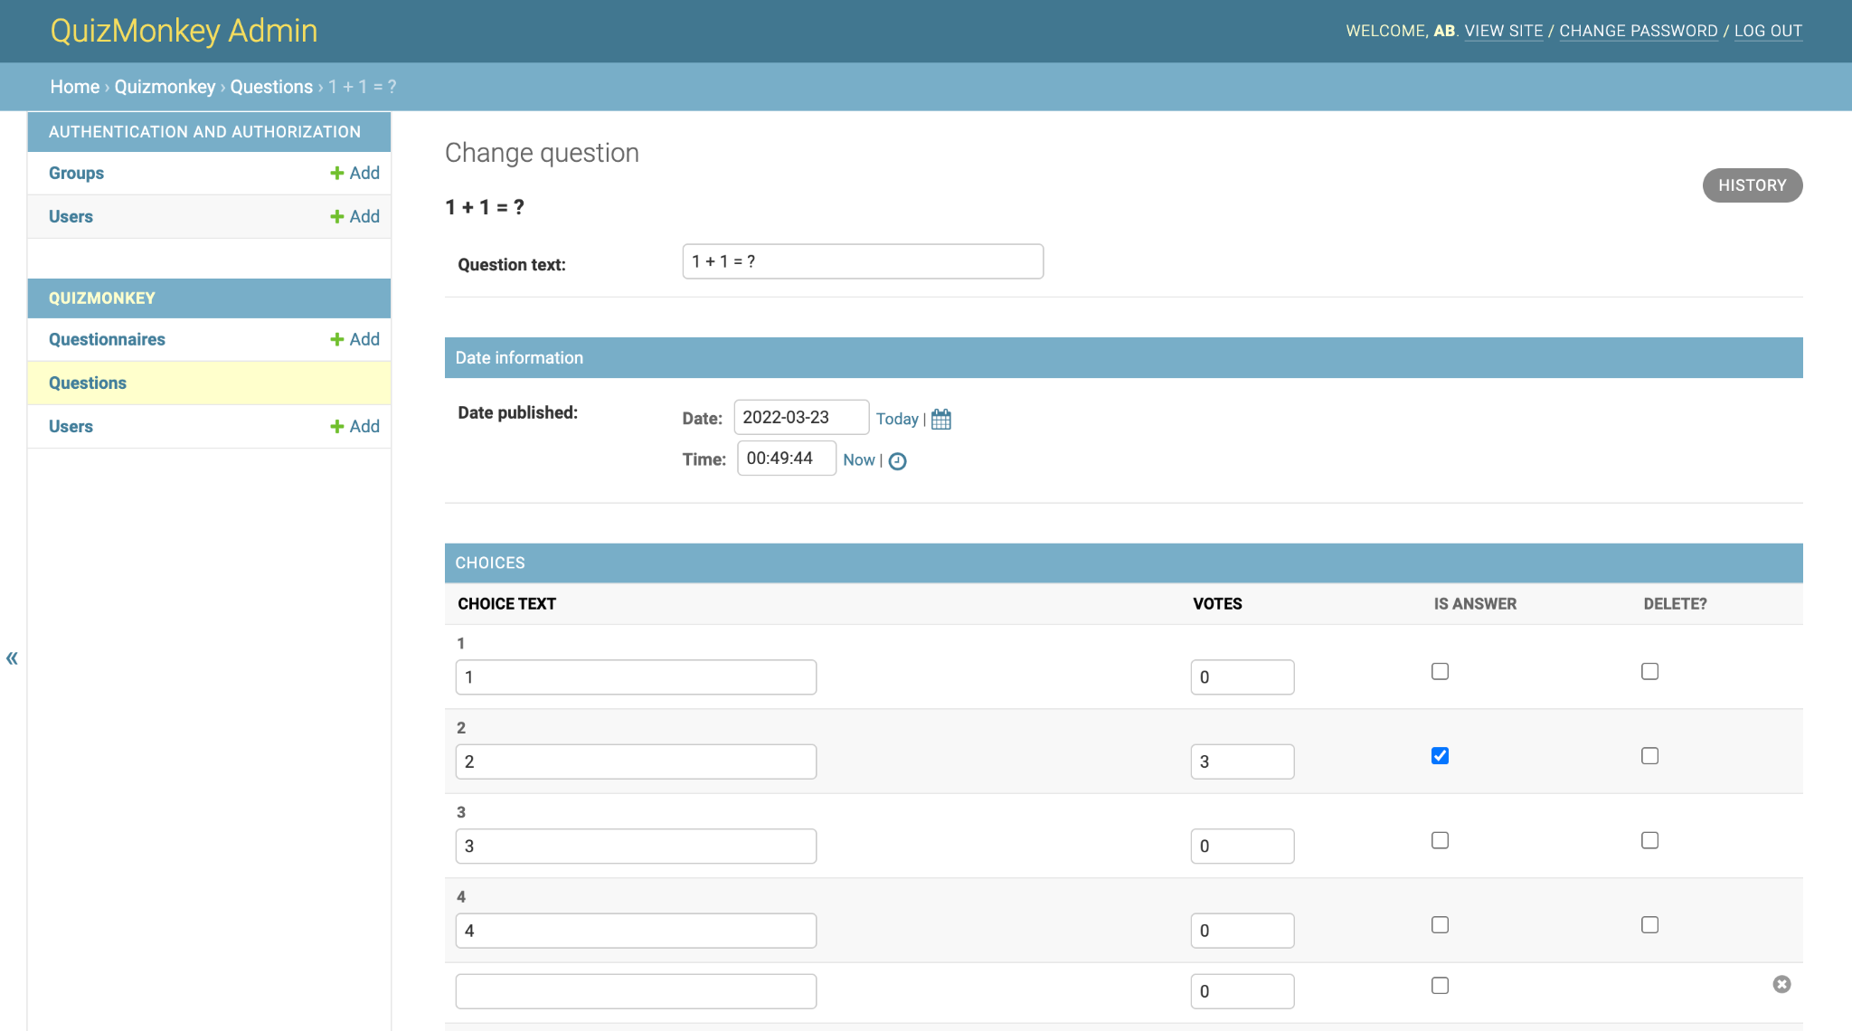
Quiz creation page (Sprint 1)

Slide 13
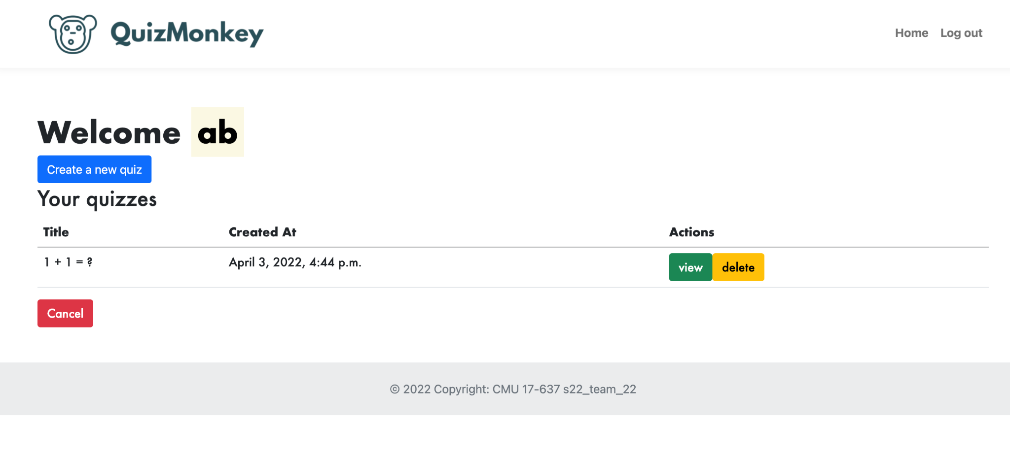
Quiz creation page

Slide 14
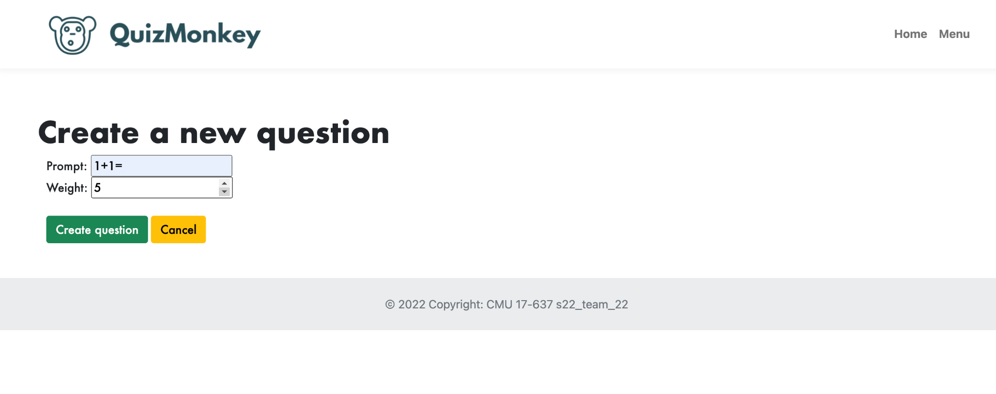
Question creation page

Slide 15
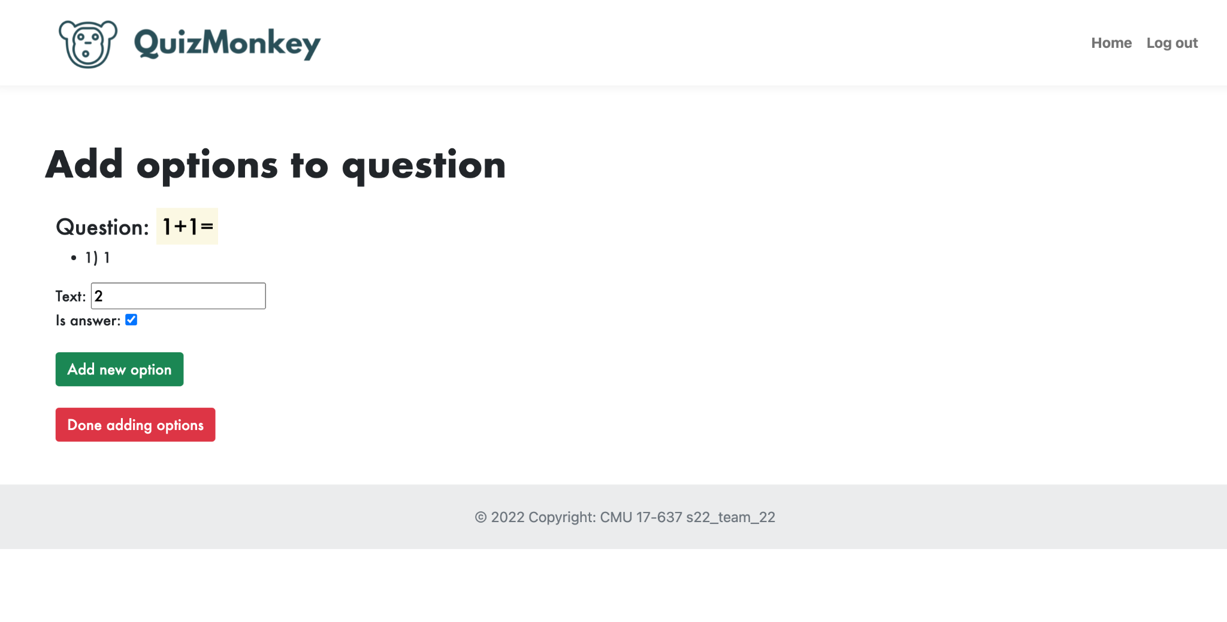
Option creation page

Slide 16
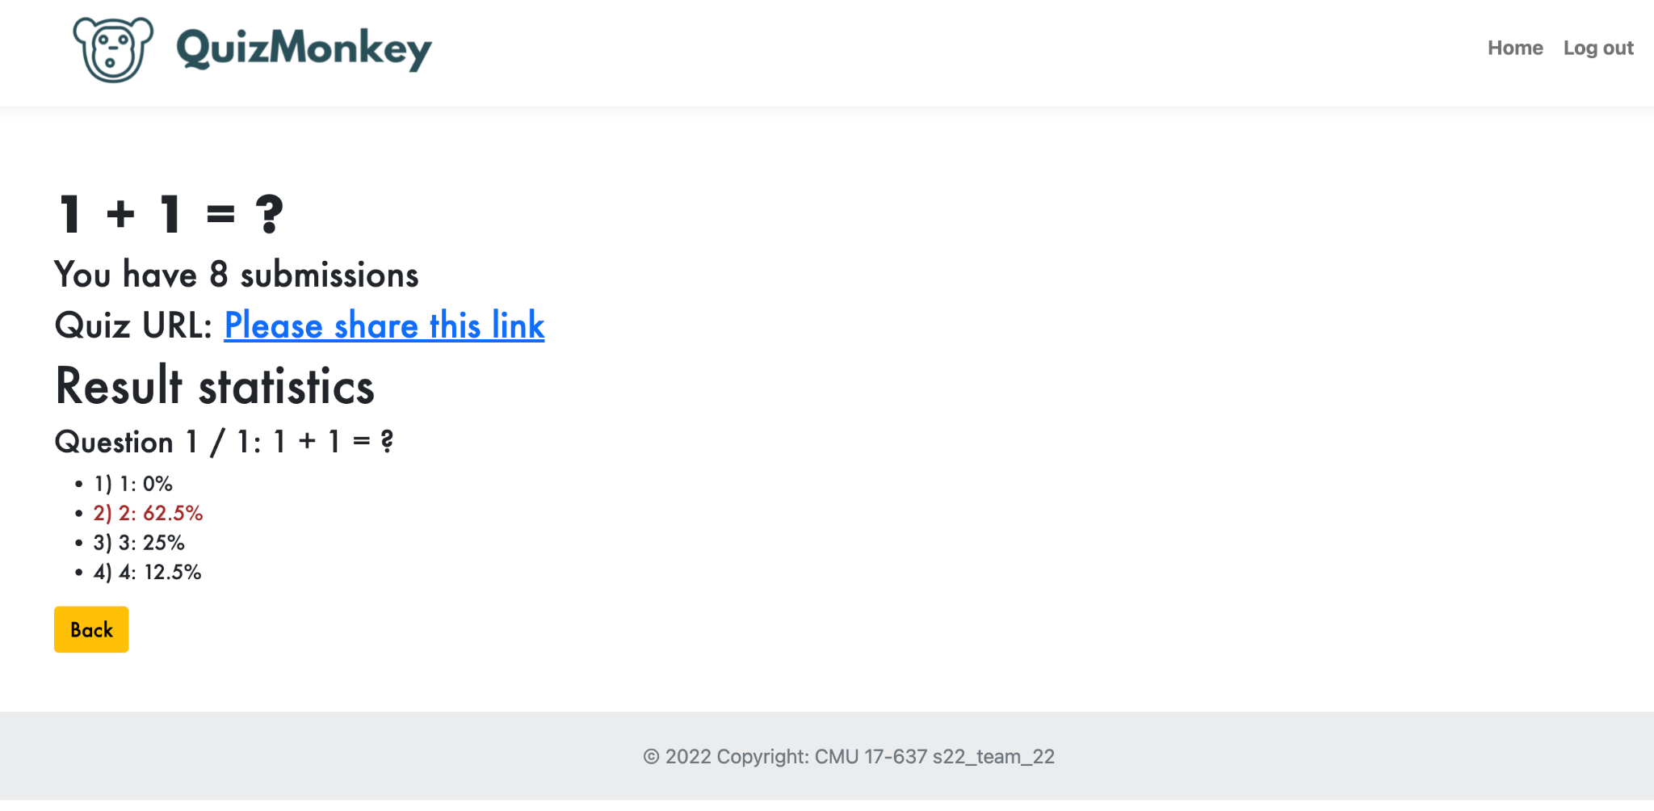
Quiz Stats Display

Slide 17
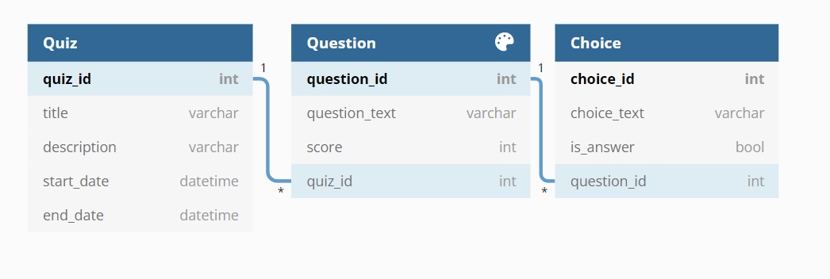
Database models
One Quiz can contain multiple Question, one Question belongs to one Quiz. (Quiz : Question, one - many relationship )
One Question can contain multiple Choice, one Choice belongs to one Question. (Question : Choice, one - many relationship )
https://stackoverflow.com/questions/1764435/database-design-for-a-survey

Slide 18
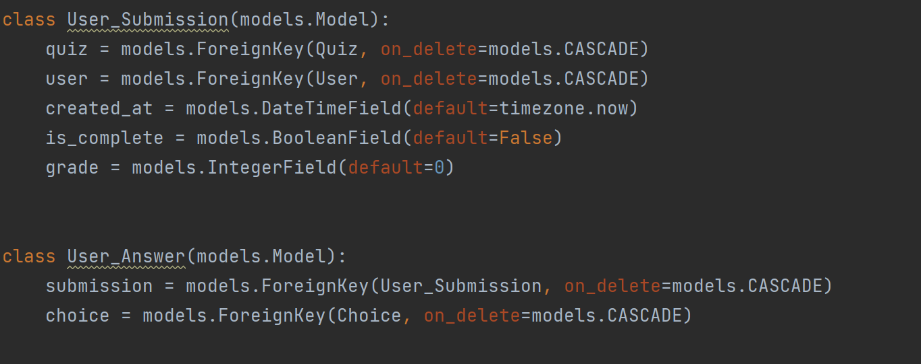
Django models

Slide 19
Progress and Challenges
Progress:
Login/Register function
New Front pages
Score calculation

Slide 20
Progress and Challenges
Challenges:
Optimization of queries
To generate multiple forms inside a page

Slide 21
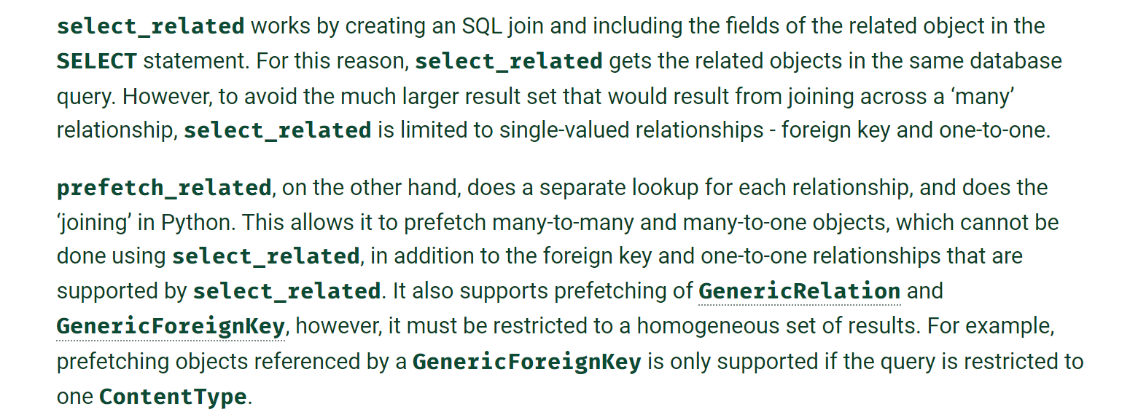
Progress and Challenges
Optimization of queries
Use select_related and prefetch_related
https://docs.djangoproject.com/en/4.0/ref/models/querysets/#values-list

Slide 22
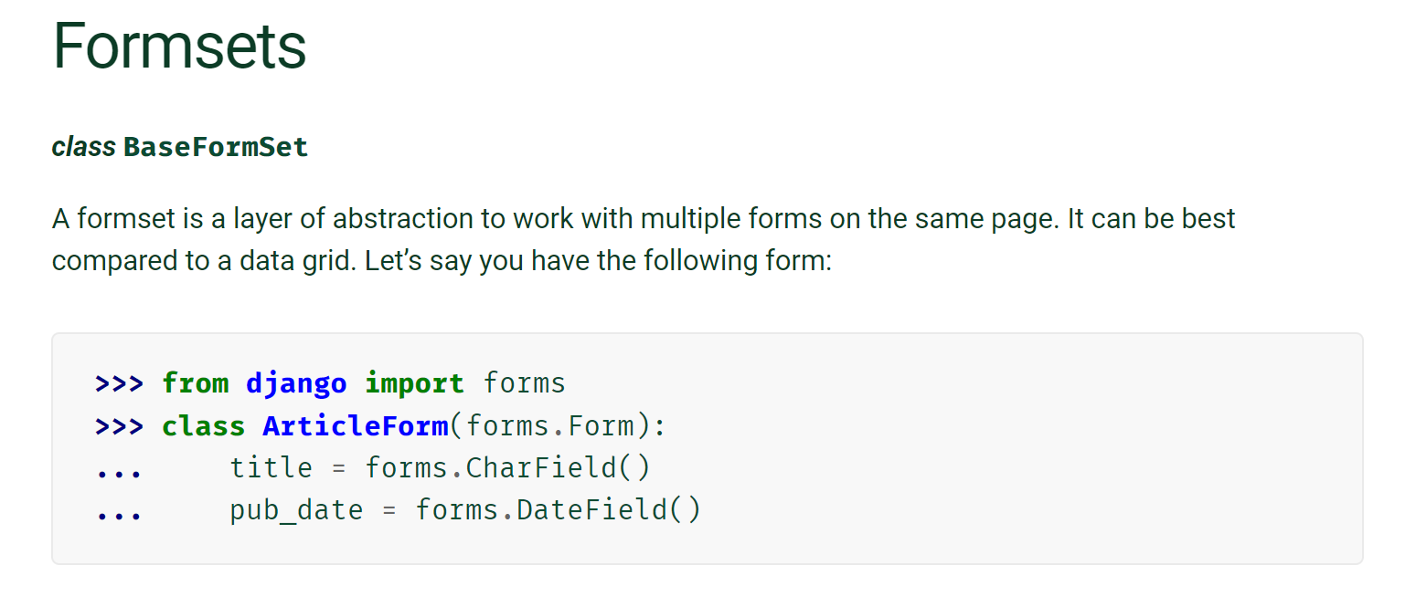
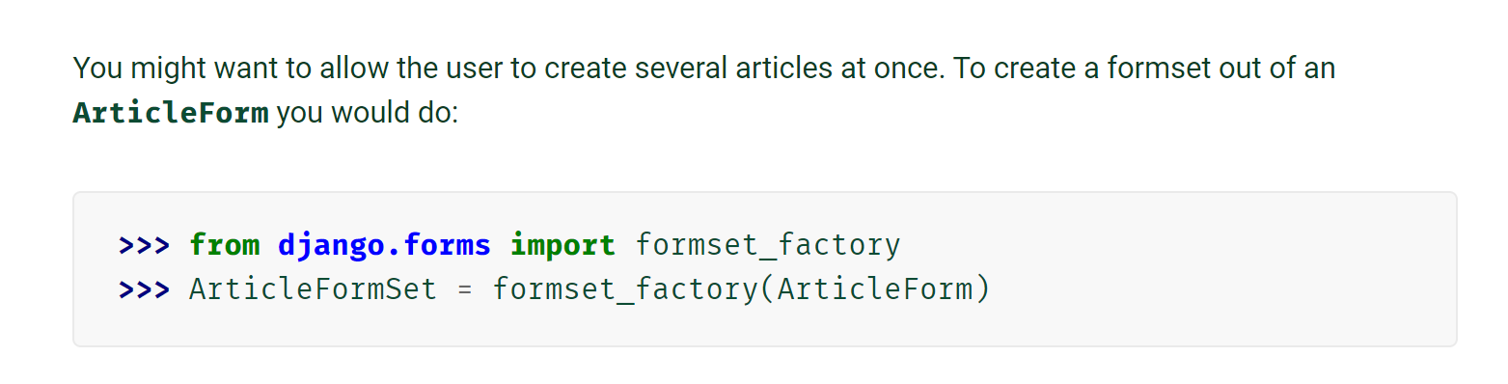
Progress and Challenges
To generate multiple forms inside a page
Use Formsets
https://docs.djangoproject.com/en/4.0/topics/forms/formsets/#adding-additional-fields-to-a-formset

Slide 23
Final Deliverable Plan
Revise current project
To solve the quiz creation error, we decided to implement Ajax for quiz creation in our final deliverable.
Replace the shable link to PIN code. The participants can enter the quiz by using PIN code without login.
Introduce new functionality
Finish the quiz result analysis function.

Slide 24
Demo

Slide 25
Thank you!

